Slide 1
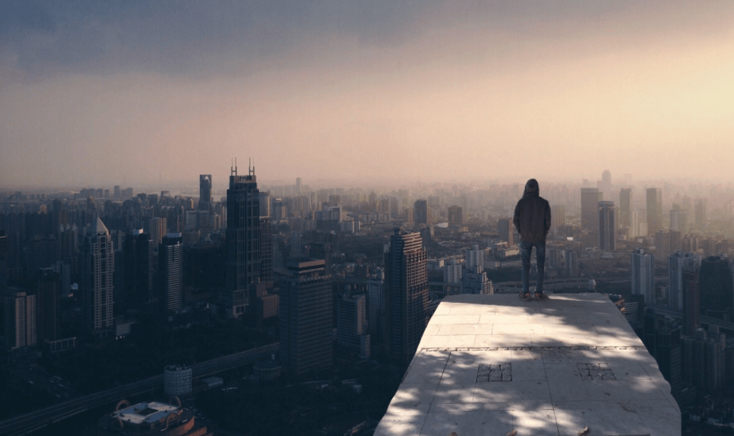
We would settle in a big city

Slide 2
Ⅰ Environment
Ⅱ Transportation
CONCENTS
Ⅲ Opportunities
Ⅳ Culture

Slide 3
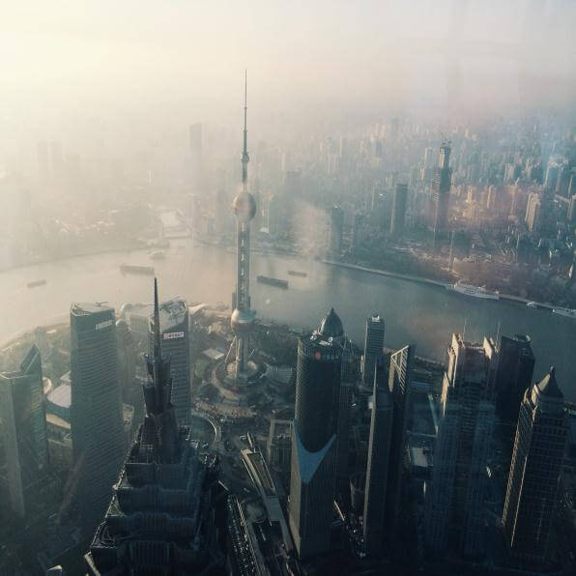
03
Opportunities

Slide 4
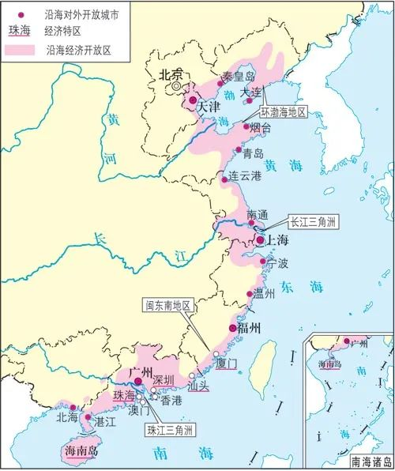
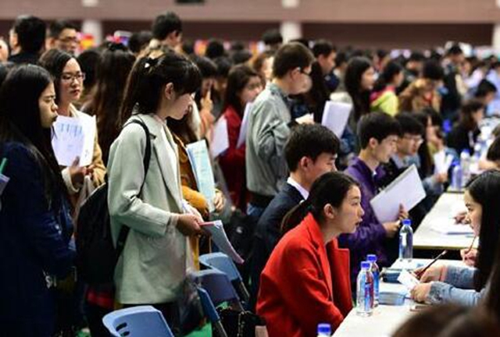
Big cities’location attracts people
big cities located near the sea
many people come here for living
Notes:
https://www.ypppt.com/

Slide 5
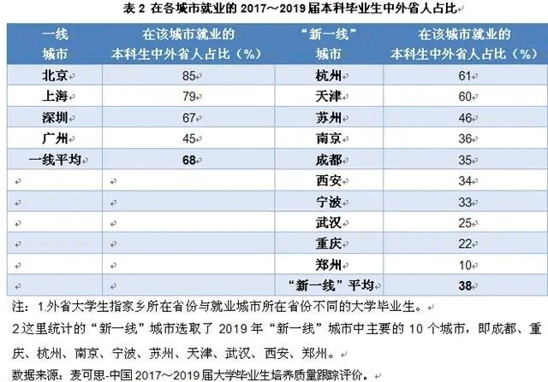
Excellent people makes you a better man
You have to work hard to compete with others

Slide 6
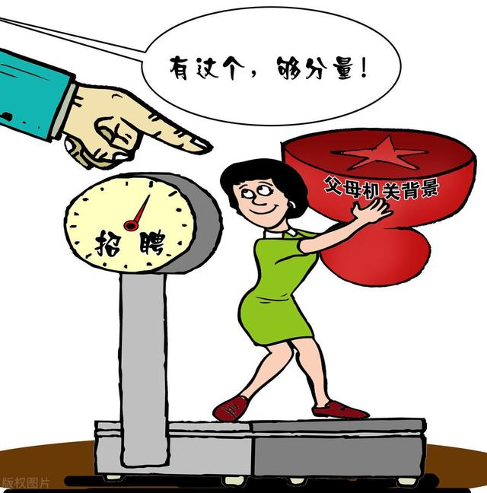
Family relationship
There is a phenomena that more and more people in China get their jobs through their family relationship.

Slide 7
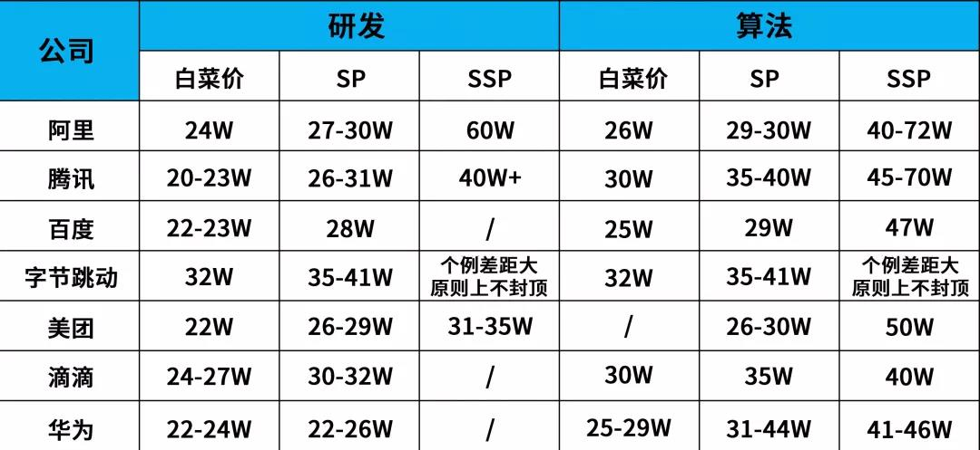

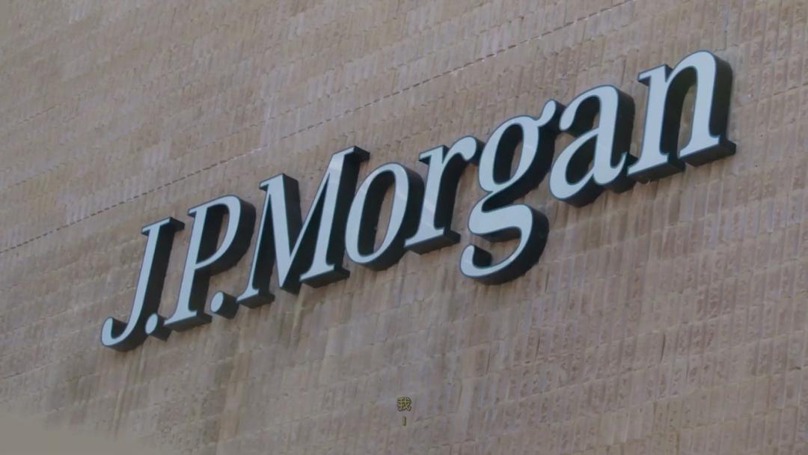

Big companies
The biggest advantage that staying in big cities is that you can find a job in big or international companies like Byte Dance、Tencent and JPMorgan.Working in these companies means that you may get one million a year.

Slide 8
Thanks for listening

